Slide 1
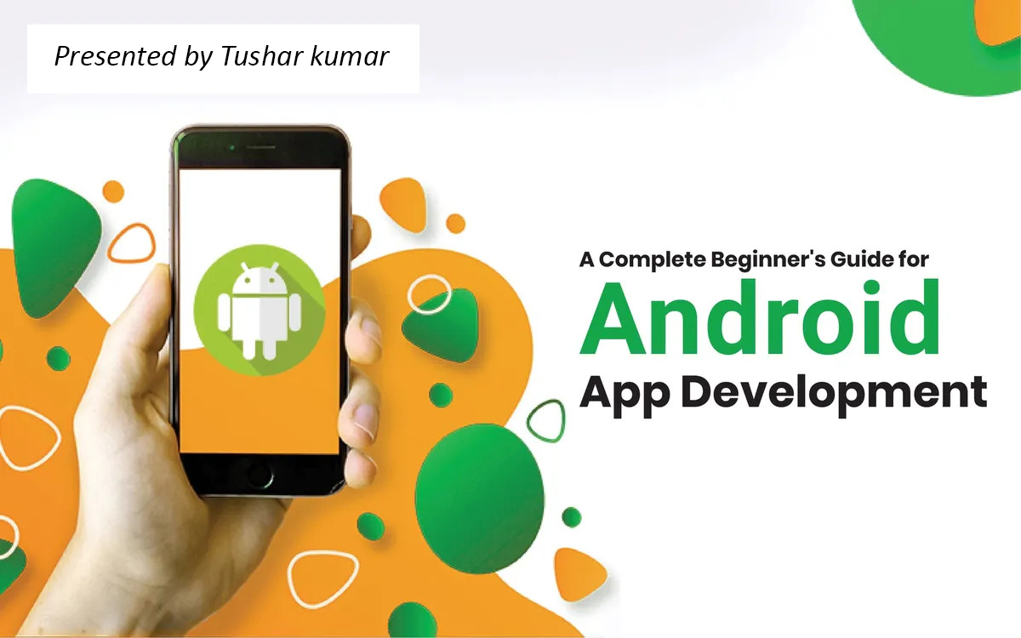

Slide 2
Introduction to Android Development
Android development is the process by which applications are created for devices running the Android operating system.
Android is a operating system based on a modified version of the Linux kernel and other open source software, designed primarily for touchscreen mobile devices such as smartphones and tablets.
The company named Open Handset Alliance developed Android for the first time that is based on the modified version of the Linux kernel and other open-source software.
Google states that "Android apps can be written using Kotlin, Java, and C++ languages" using the Android software development kit (SDK).
At first, the purpose of Android was thought of as a mobile operating system. However, with the advancement of code libraries and its popularity among developers of the divergent domain, Android becomes an absolute set of software for all devices like tablets, wearables, set-top boxes, smart TVs, notebooks, etc.

Slide 3
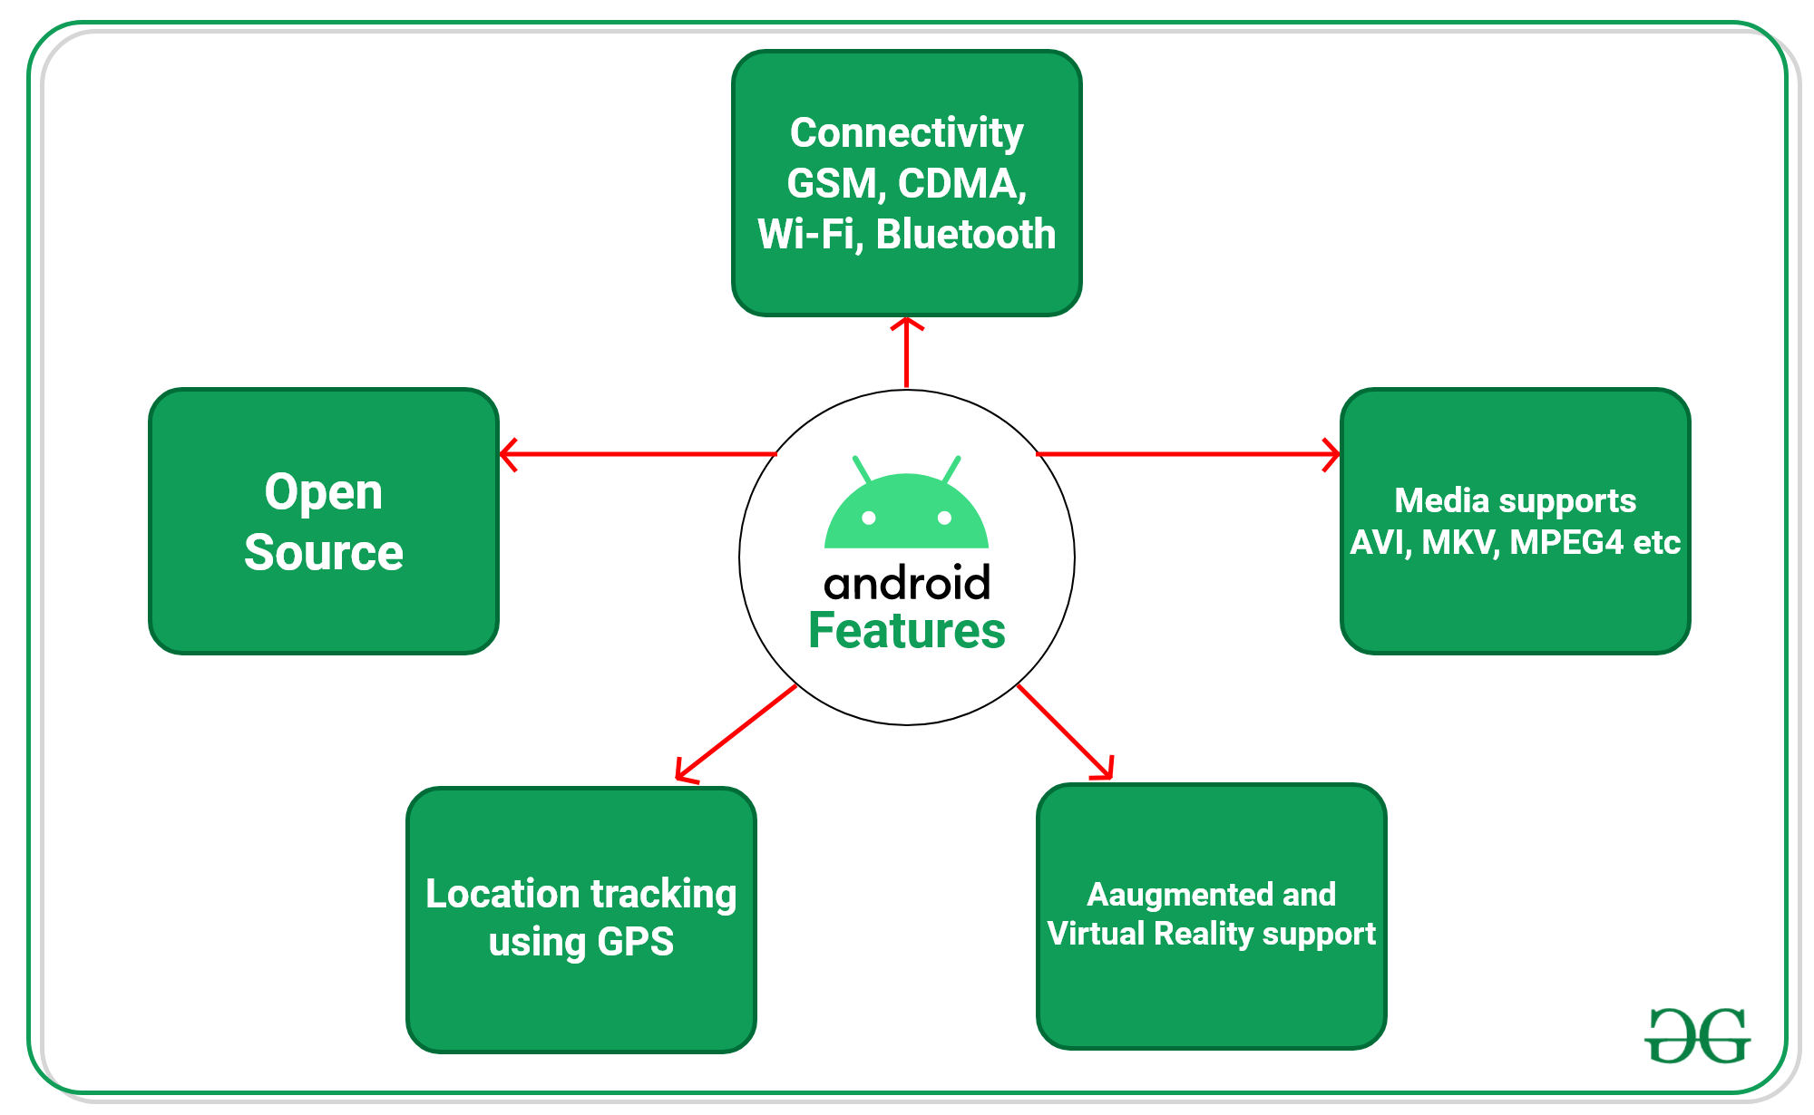
Features of Android
Android is a powerful open-source operating system that open-source provides immense features and some of these are listed below.

Slide 4
Features of Android
Android Open Source Project so we can customize the OS based on our requirements.
Android supports different types of connectivity for GSM, CDMA, Wi-Fi, Bluetooth, etc. for telephonic conversation or data transfer.
Using wifi technology we can pair with other devices while playing games or using other applications.
It contains multiple APIs to support location-tracking services such as GPS.
We can manage all data storage-related activities by using the file manager.
It contains a wide range of media supports like AVI, MKV, FLV, MPEG4, etc. to play or record a variety of audio/video.
It also supports different image formats like JPEG, PNG, GIF, BMP, MP3, etc.
It supports multimedia hardware control to perform playback or recording using a camera and microphone.
Android has an integrated open-source WebKit layout-based web browser to support User Interfaces like HTML5, and CSS3.
Android supports multi-tasking means we can run multiple applications at a time and can switch between them.
It provides support for virtual reality or 2D/3D Graphics.

Slide 5
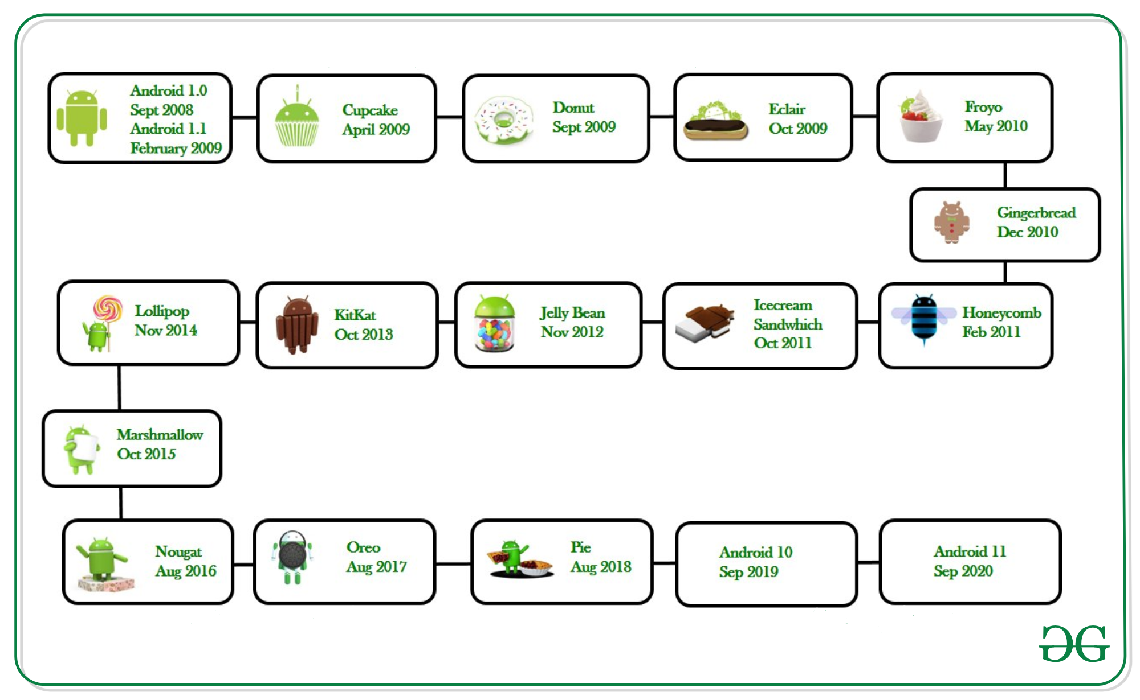
Android Versions
Google first publicly announced Android in November 2007 but was released on 23 SEPTEMBER 2008 to be exact. The first device to bring Android into the market was the HTC Dream with the version Android 1.0. Since then, Google released a lot of android versions such as Apple Pie, Banana Bread, Cupcake, Donut, Éclair, Froyo, Gingerbread, Jellybeans, Kitkat, Lollipop, marshmallow, Nougat, Oreo, etc. with extra functionalities and new features.

Slide 6
Programming Languages used in Developing Android Applications
Java
Kotlin
Developing the Android Application using Kotlin is preferred by Google, as Kotlin is made an official language for Android Development, which is developed and maintained by JetBrains.
Previously before Java is considered the official language for Android Development.
Kotlin is made official for Android Development in Google I/O 2017.

Slide 7
Advantages of Android Development
The Android is an open-source Operating system and hence possesses a vast community for support.
The design of the Android Application has guidelines from Google, which becomes easier for developers to produce more intuitive user applications.
Fragmentation gives more power to Android Applications. This means the application can run two activities on a single screen.
Releasing the Android application in the Google play store is easier when it is compared to other platforms.

Slide 8
Disadvantages of Android Development
Fragmentation provides a very intuitive approach to user experience but it has some drawbacks, where the development team needs time to adjust to the various screen sizes of mobile smartphones that are now available in the market and invoke the particular features in the application.
The Android devices might vary broadly. So the testing of the application becomes more difficult.
As the development and testing consume more time, the cost of the application may increase, depending on the application’s complexity and features.

Slide 9


